Slide 1





KNOWLEDGE TRANSFER GENERATOR
Vishal Gokul SL & Aryan Rajesh

Slide 2
What is Knowledge Transfer Generator ?
Knowledge transfer refers to the process of sharing or disseminating knowledge, skills, and expertise from one person, group, or organization to another. This concept is crucial in various fields, including business, education, and technology, to ensure that valuable information is effectively communicated and utilized.
In the world of IT and Software Development, knowledge transfer (KT) stands out as a big challenge. Whether it’s new hires trying to understand their roles, folks on their notice periods aiming for a smooth handover, or the daily tasks of developers and product specialists adapting to ever-changing projects — the KT process often leads to stress and worry.

Slide 3
Solution and steps to solve this problem
The solution has four stages:
Code Parsing:
Break down the code base into individual code snippets or blocks.
Summary and Explanation Generation with LlamaIndex:
Produce a comprehensive summary of the entire code base.
Create detailed explanations for each individual code block using LlamaIndex.
Video Creation with D-ID:
Generate videos using text-to-speech capabilities provided by D-ID.
Video-Code Integration:
Seamlessly stitch together the individual code blocks with their corresponding generated videos.

Slide 4
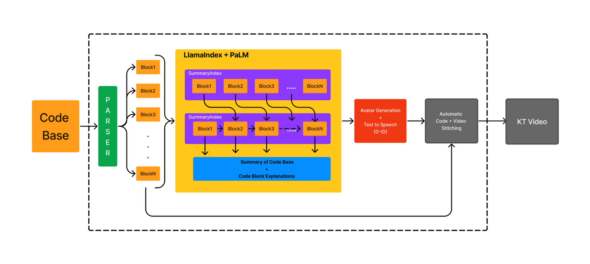

Slide 5
1.Understanding Code:
- To effectively understand a code base, start with a high-level summary that gives an overview of the code's structure and purpose.
- However, true understanding requires digging into individual code snippets or blocks, which provide specific details about how the code functions.
2. Challenges with Full Code Bases:
- Providing explanations using entire code bases can be overwhelming for language models (LLMs) because of token limits (maximum amount of text they can process) and the risk of missing important details.
3. Approach:
- To address these challenges, break the code into smaller, more manageable sections. This segmentation might include import statements, classes, initializers, and methods.
- This approach ensures that explanations remain focused and detailed without overwhelming the model.
4. Dependency Graph:
- Use Python’s `ast` (Abstract Syntax Tree) library to analyze the structure of the code.
- By examining the code’s structure, you can extract and understand key components like classes, their docstrings (documentation strings), initializers (constructor methods), and other methods.
5. (code_parser) Class:
- This class embodies the strategy of breaking down the code into meaningful sections.
- It differentiates between module-level functions (functions defined outside of classes) and class-nested functions (methods defined within classes).
- The class organizes these components systematically to maintain the code’s logical flow.

Slide 6
USP & Market Opportunity
Auto video creation for code explanation is novel and only text explanation existed until now
Extremely useful for both small/large organizations to save precious man hours and cost.
As mentioned previously, there’s a cost saving in the order of 250M+ for large organizations.
Our target audience is essentially IT folks like new hires for onboarding, people on notice period or just general developers/product people.

Slide 7
Video Creation with D-ID:
After carefully crafting summaries and detailed explanations for each code block, it’s essential to convey this information in a captivating and accessible manner. Videos, given their dynamic appeal, have the power to make intricate code explanations clearer and more engaging. This is where D-ID comes into play.
With the prowess of D-ID’s cutting-edge technology, we’re able to create realistic videos where avatars — whether they’re of us or another chosen figure — articulate each code block. Now, what brings these avatars to life? The answer lies in Microsoft’s text-to-speech synthesizer. This tool takes our detailed textual explanations and transforms them into natural, fluent speech. Thus, with D-ID, we’re not just generating video but also integrating audio, culminating in a comprehensive and fluid video explanation.
To see this in action, let’s take a look at a sample output

Slide 8
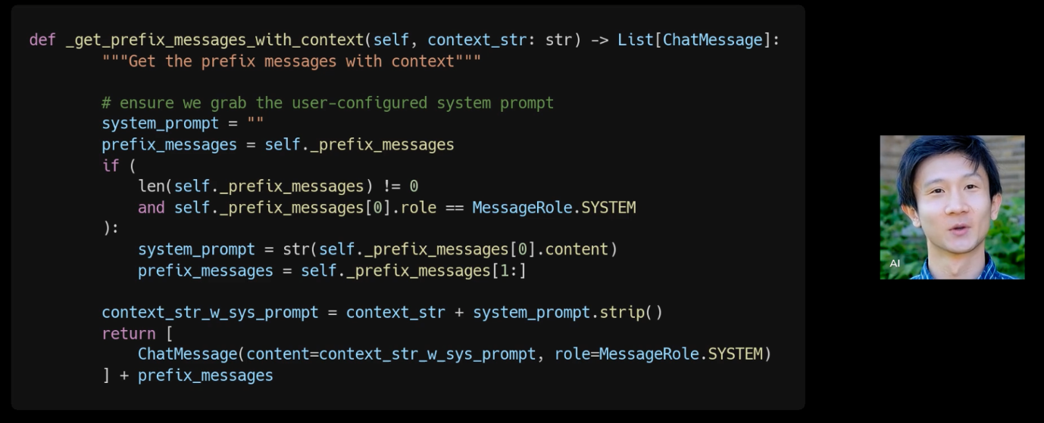
Video Audio-Code Integration:
Generate Insightful Videos: Create videos with avatars that explain the code.
Prepare Code Snippets: Have your code snippets ready for integration.
Transform Code into Visuals: Use the carbon library to convert code snippets into visually appealing images.
Integrate Code Images and Videos: Place the code images alongside the video to provide a clear, simultaneous view of the code and explanation.
Combine Video and Images: Use the (moviepy library) to merge the video and code images into a single, cohesive video.
Demo

Slide 9
Conclusion and Future plans:
1. Showcasing LlamaIndex: - Demonstrates the transformative potential of LlamaIndex for creating Knowledge Transfer (KT) Videos specifically for code bases.
2. Advancements in Knowledge Transfer: - Highlights the significant progress being made in the field of Knowledge Transfer through innovative video explanations of code.
3. Language-Neutral Methodology: - Emphasizes that the approach is adaptable to various programming languages, providing flexibility for different code bases.
4. Scalability Potential: - Suggests that with modifications to the code parsing phase, the methodology can be scaled to handle large code repositories within organizations.
5. Vision for a Platform: - Envisions a platform similar to YouTube, potentially named KodeTube (KT), where an organization’s entire codebase could be documented and explained through videos
6. Future Opportunities: - Expresses enthusiasm about the future prospects and potential of LlamaIndex in revolutionizing how code knowledge is shared and managed.

Slide 10
Thank You

